Slide 1
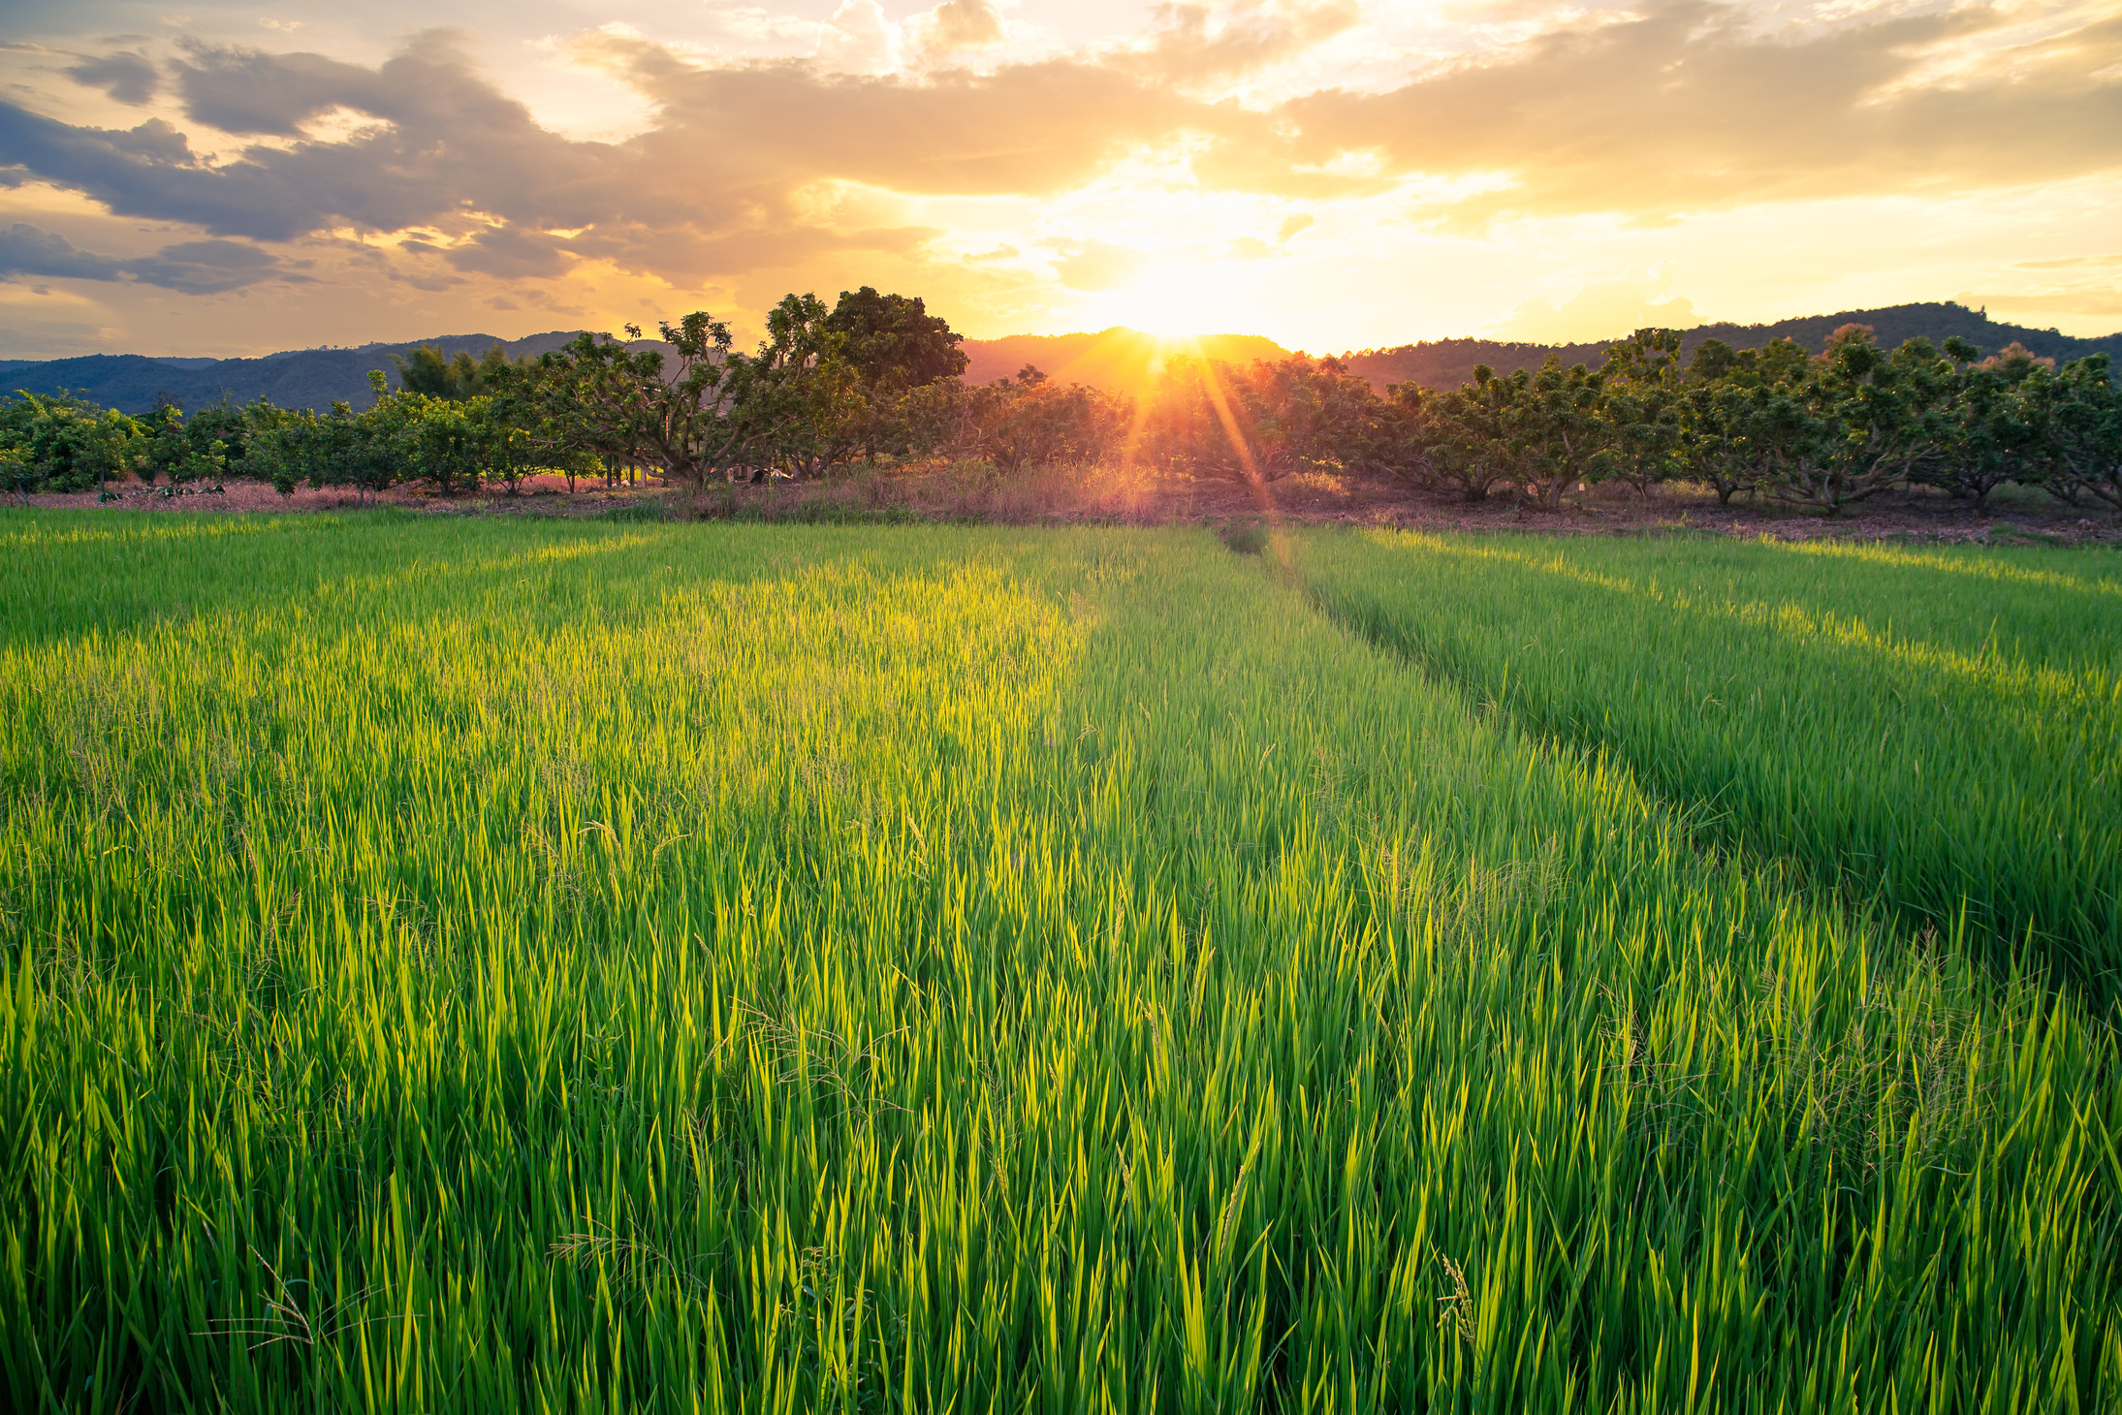

CYBERCROW
ENTERPRISE-SCALE AGROSURVEILLANCE AND CONTROL SYSTEM FOR INDUSTRIAL AGRICULTURE
NADIL GUNAWARDANE
NIDULA GUNAWARDANE
NADUN NAWANJANA
Achievements
The agricultural industry is on the use of technology

Slide 2
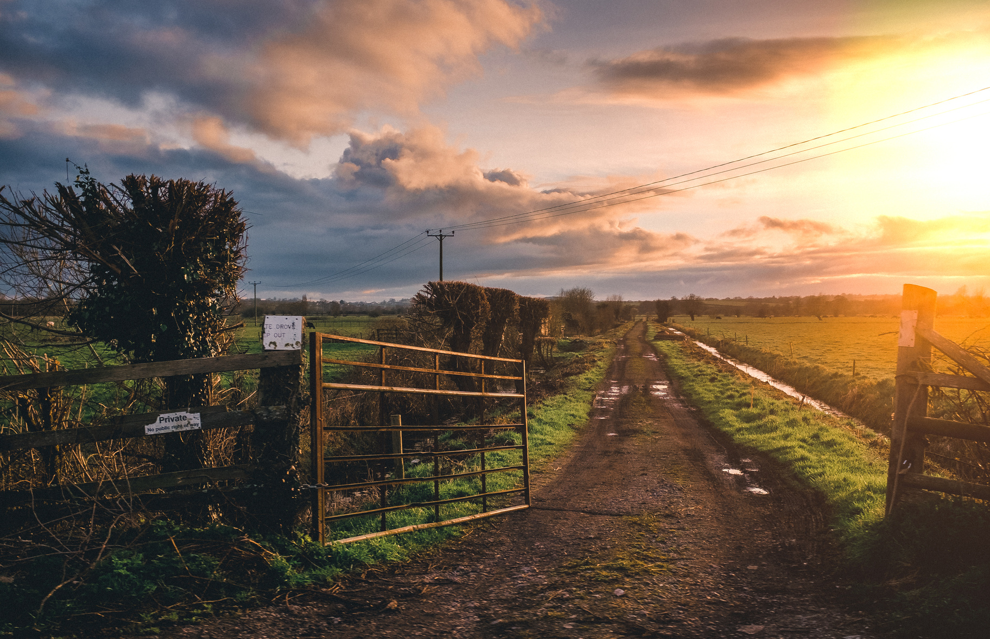

AGRICULTURE
Real-time Monitoring
Data-Driven Decision-Making
Early Detection of Threats
Optimized Resource Management
Increased Yield and Crop Quality
Cost Savings
Why a surveillance system for agricultural lands ?

Slide 3

24-hour surveillance system which,
Monitors animal activity
Measures soil moisture and nutrition level
Detect pests
Make predictions, identify threats, and inform the farmers
What is CyberCrow ?

Slide 4

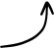
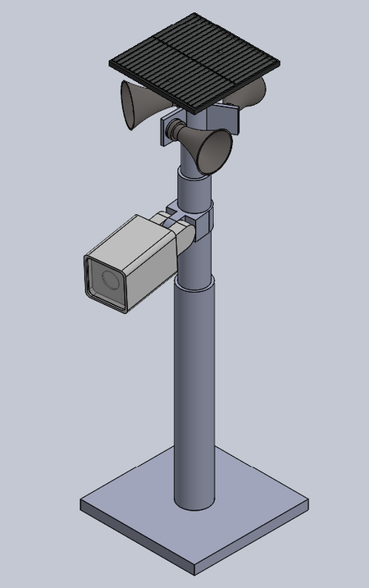
AGRICULTURE
SPEAKER
POWER SUPPLY
SOIL MOISTURE SENSOR
Anatomy of CyberCrow
ESP 32 CAM MODULE
ESP 32 DEVELOPMENT BOARD
POWER SUPPLY
TEMPERATURE AND HUMIDITY
SOIL NPK SENSOR

Slide 5

CyberCrow is a highly expandable and adaptive platform.
50m radius coverage
Modular components
Integration with existing components
Ease of expansion
AGRICULTURE
How does CyberCrow fit the market?
Universal Applicability
Comprehensive solution
Cost-effectiveness
Environmental sustainability
How good our product fits in the market ?

Slide 6
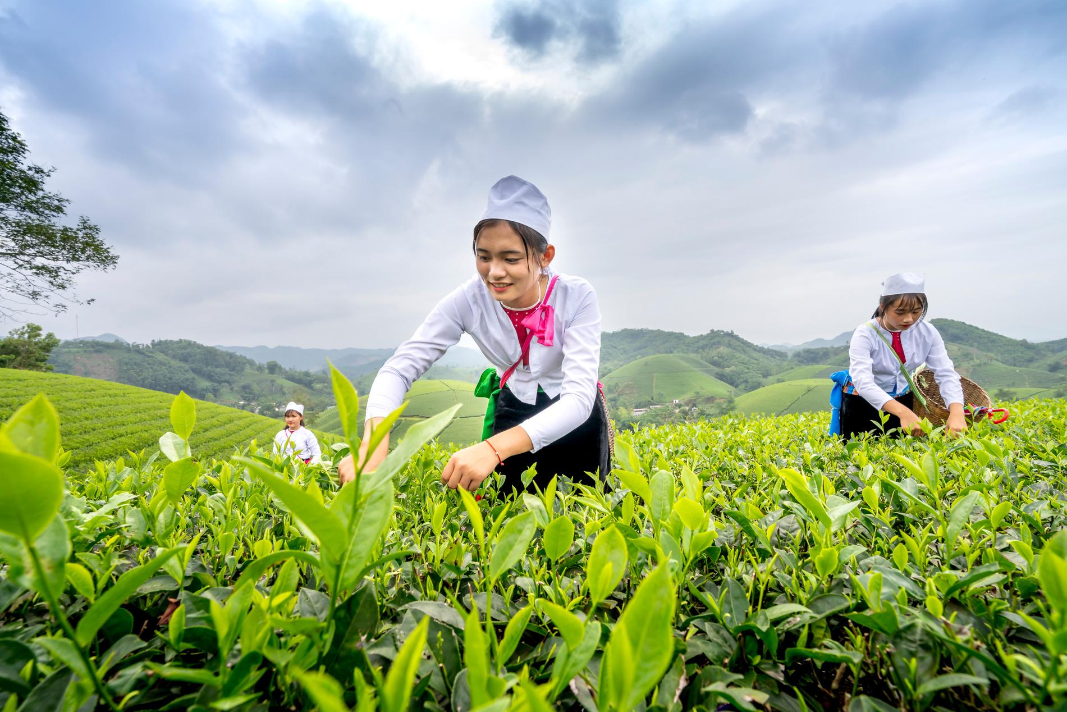

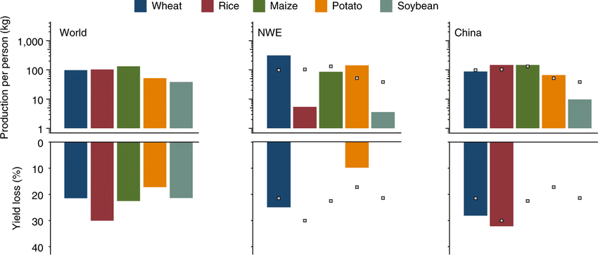
In the first half of 2022, Sri Lanka incurred a substantial economic loss of approximately 30,000 million rupees due to crop destruction caused by wild animals.
According to USDA 20% to 40% of global production is lost to pest annually costing around $220 billion
AGRICULTURE
How the market will change with CyberCrow’s implementation?
Savary, Serge & Willocquet, Laetitia & Pethybridge, Sarah & Esker, Paul & McRoberts, Neil & Nelson, Andy. (2019). The global burden of pathogens and pests on major food crops. Nature Ecology & Evolution. 3. 1. 10.1038/s41559-018-0793-y.

Slide 7
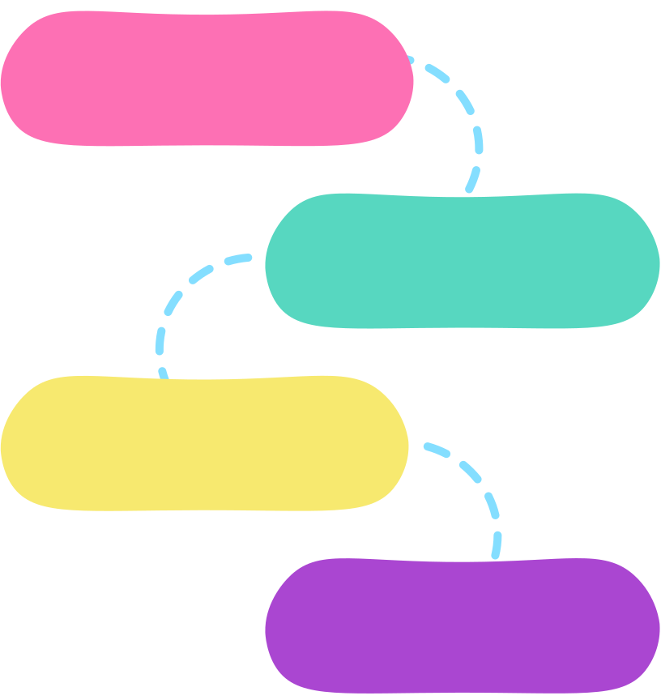
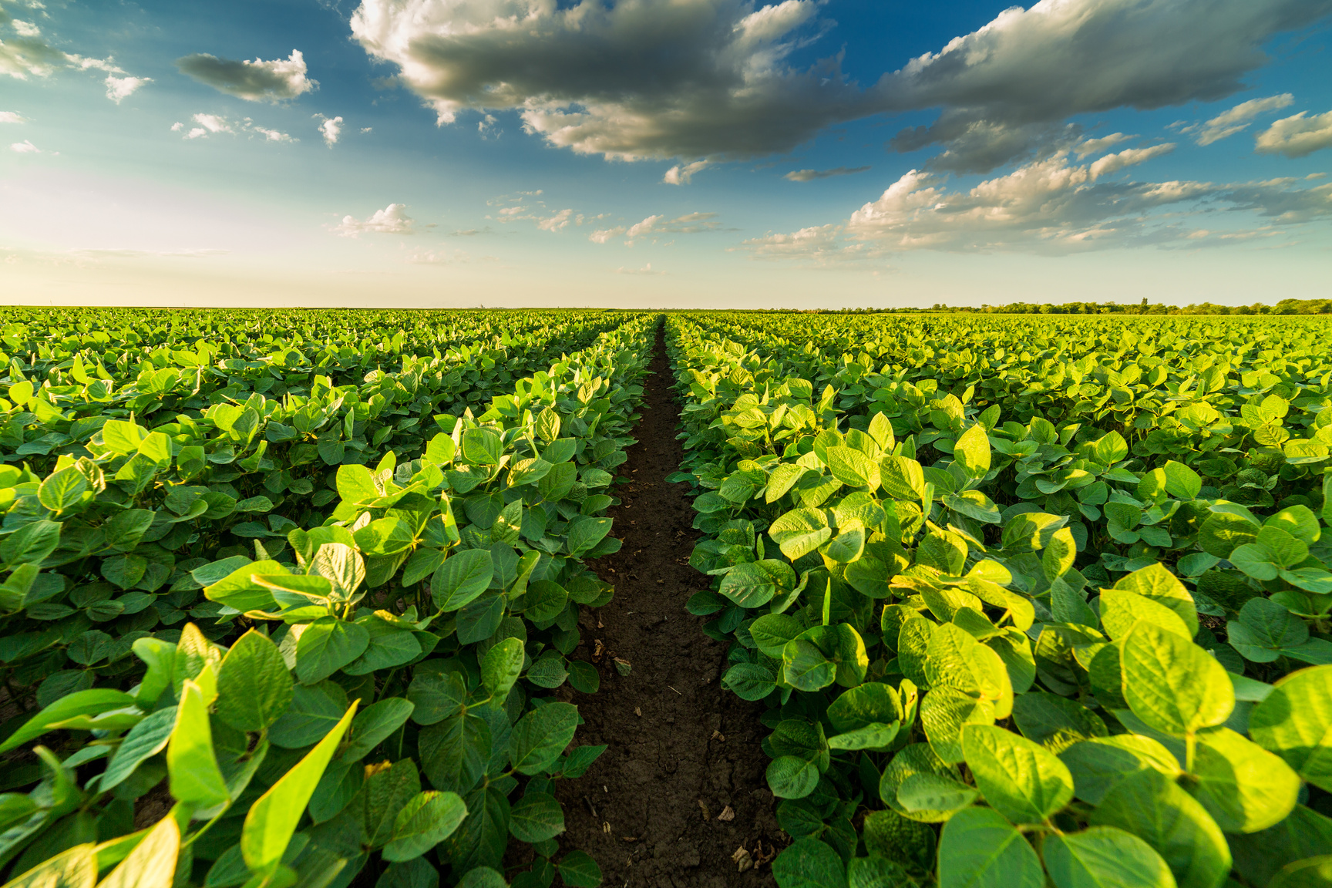

CyberCrow will save billions of dollars!
MARKET ANALYSIS AND PROBLEM IDENTIFICATION
PRODUCT DEVELOPMENT AND DIFFERENTIATION
MARKET STRATEGY AND IMPLEMENTATION
FINANCIAL PROJECTION AND VIABILITY

Slide 8
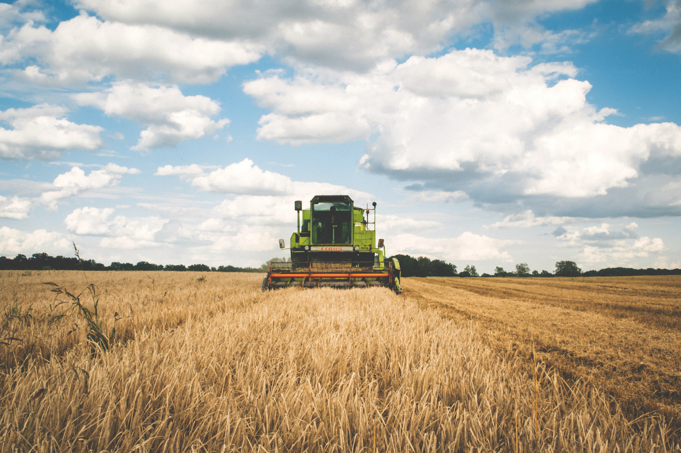


Viability
Risk
Market demand
Competitive landscape
ROI
Scalability
Regulatory compliances
Technological risk
Market Acceptance
Operational challenges
Supplier dependencies
Regulatory changes
How CyberCrow will assess the viability and manage risk?

Slide 9
Thank
You
References:
[1] Savary, Serge & Willocquet, Laetitia & Pethybridge, Sarah & Esker, Paul & McRoberts, Neil & Nelson, Andy. (2019). The global burden of pathogens and pests on major food crops. Nature Ecology & Evolution. 3. 1. 10.1038/s41559-018-0793-y.
[2] L. Gula, “Researchers helping protect crops from pests,” National Institute of Food and Agriculture, Feb. 06, 2023. https://www.nifa.usda.gov/about-nifa/blogs/researchers-helping-protect-crops-pests#:~:text=Between%2020%25%20to%2040%25%20of
‌
Achievements
CyberCrow will revolutionize the agricultural industry on a massive scale

